Slide 1
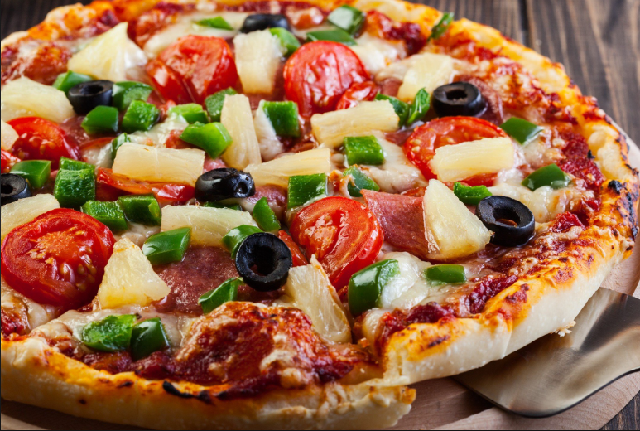
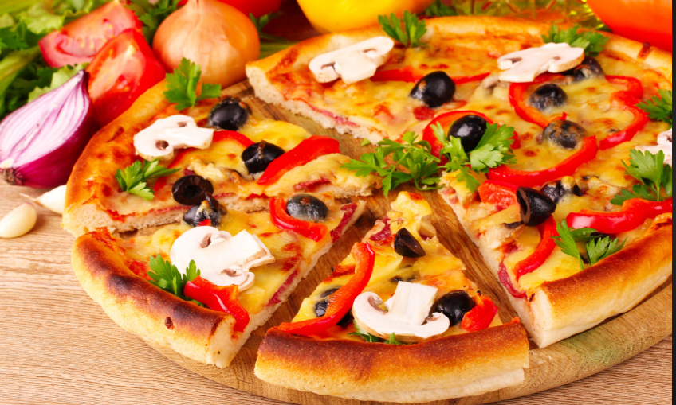
Pizzahut Analysis
Presentation By :- NAGA SIVA VARAPRASAD

Slide 2

Problem Statement
Ram is running a Pizza Hut store and has one year’s worth of data, but he is Pizza Hut wants to strengthen its Revenue & profit by understanding of customer preferences and purchasing trends.

Slide 3
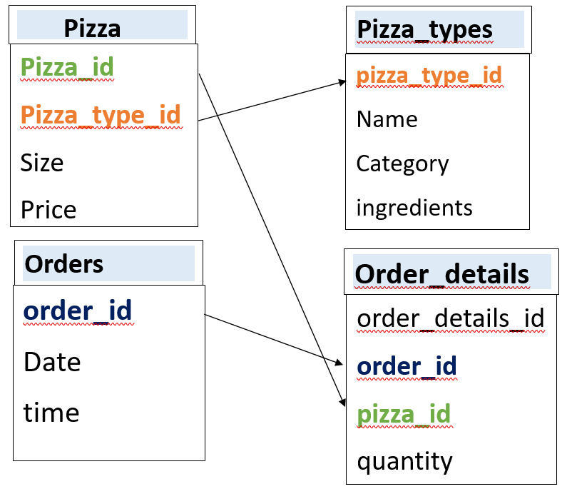
Pizzahut Data
Data consists of four tables
1.pizza 2.pizza_types
3. orders 4.Order_details
Pizza_id, pizza_type_id :-There is unique pizza id name
with size indication
Name :- Actual Name of pizza
Size,price ,ingredients :- it gives information about pizza
Size Price what ingredients are used
Orders,order_details:- There is id are created for order
Purpose.
Date & time: - order date & time
Quantity:- No of pizzas ordered.

Slide 4
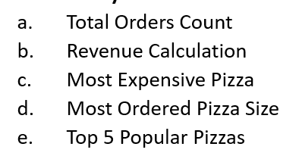
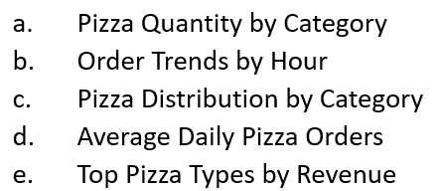
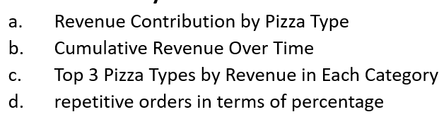
Analysis
Basic Analysis
Intermediate Analysis
Advanced Analysis

Slide 5
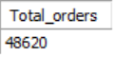
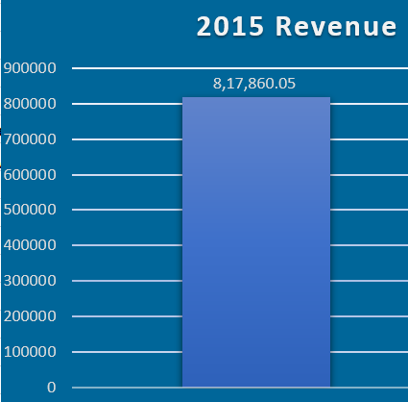
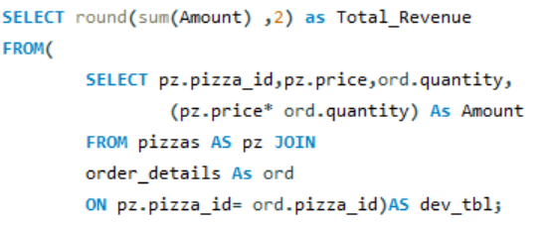
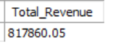
Total Number of Orders OUTPUT
Total Revenue calculation OUTPUT

Slide 6
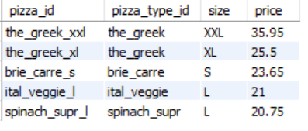
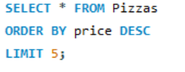
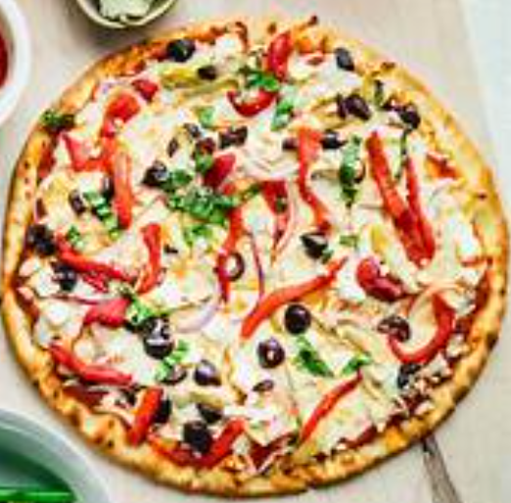
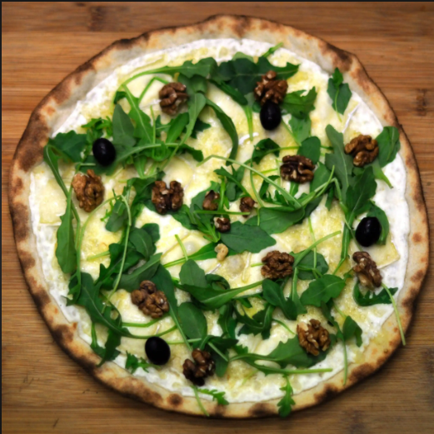
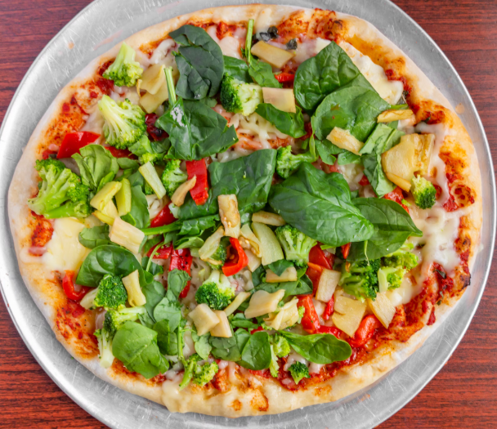
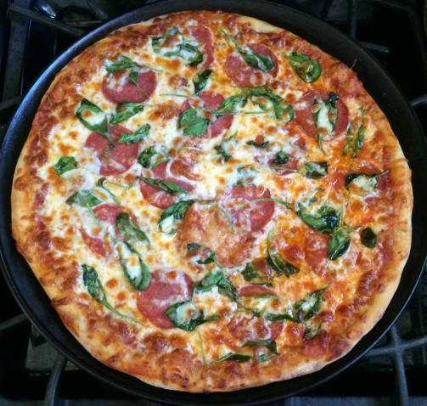
Most Expensive Pizzas OUTPUT
The_Greek_xxl
Brie_carre_s
Ital_veggie_l
Spinach_supr_l
Price $ 35.95$23.65
Price $ 25.5$23.65
Price $ 2123.65
Price $ 20.75$23.65

Slide 7
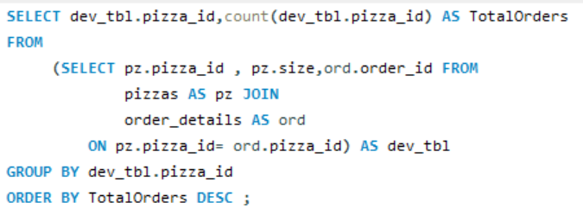
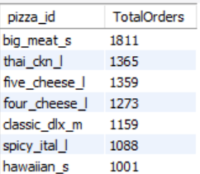
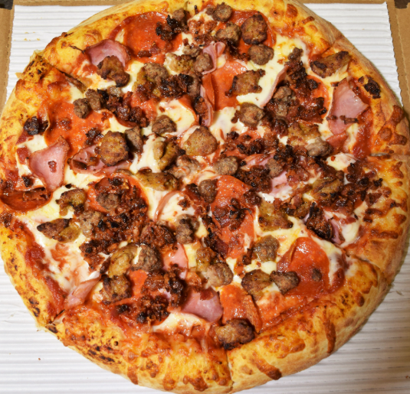
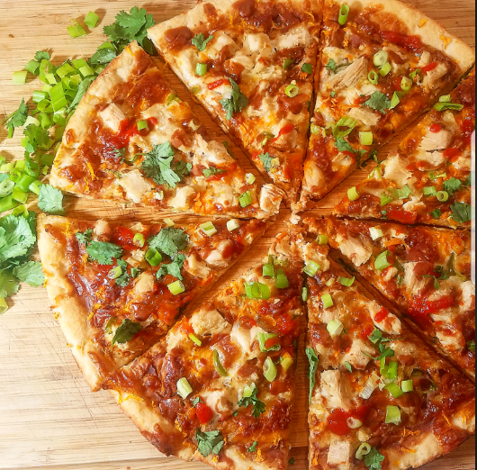
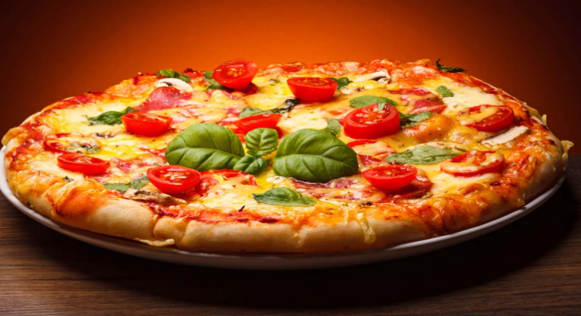
Most Ordered Pizza Size OUTPUT
Big_meat_s
Thai_ckn_l
Five_cheese_l
Orders 1811
Orders 1365
Orders 1359

Slide 8
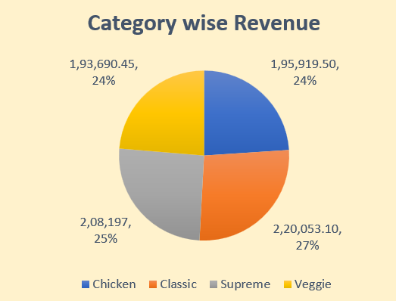
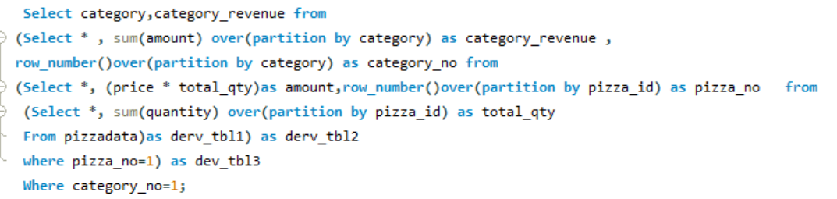
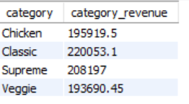
Category wise Revenue
OUTPUT

Slide 9
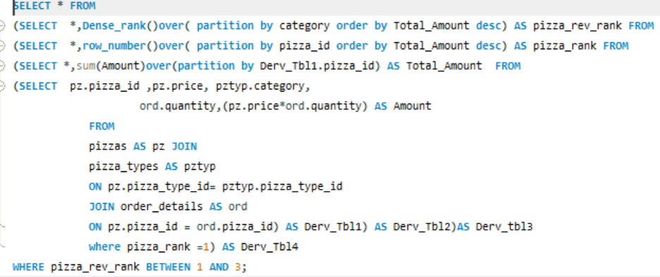
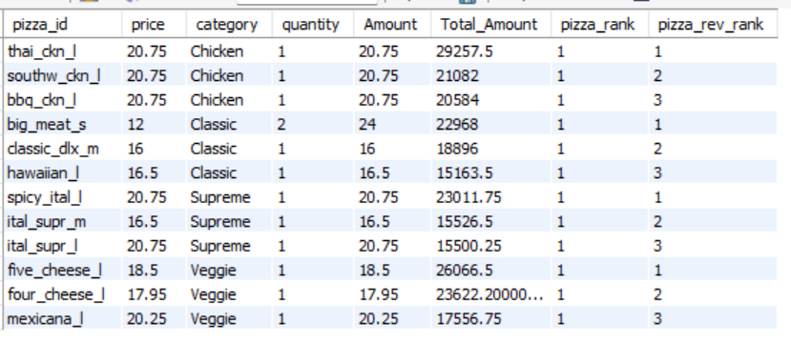
Top 3 Pizza Types by Revenue in Each Category OUTPUT
Category | Top 3 Pizzas In Revenue Contribution
Chicken | Thai_ckn,Southw_ckn,Bbq_ckn
Classic | Big_meat,Classic_dlx,Hawaiian
Supreme | Spicy_ital, Ital_super_m,Ital_super_l
Veggie | Five_cheese,Four_cheese,Mexicana

Slide 10
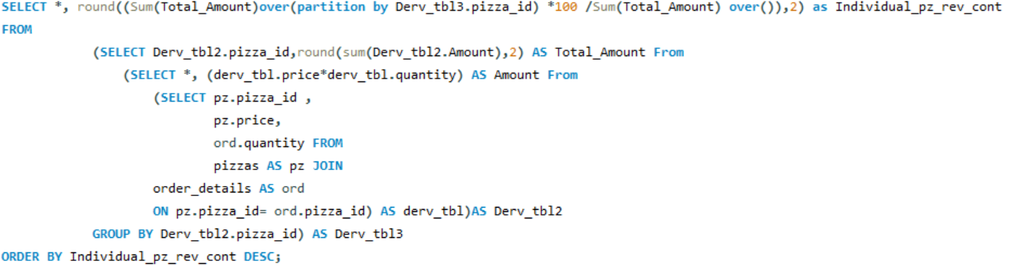
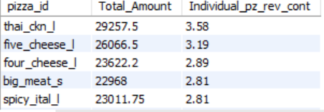
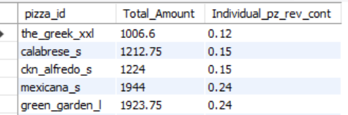
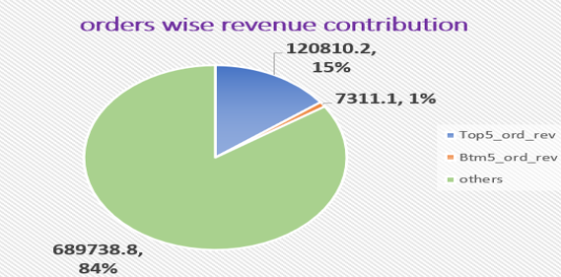
Revenue Contribution by Pizza Type Top 5 pizzas Revenue output
Bottom 5 pizzas Revenue output

Slide 11
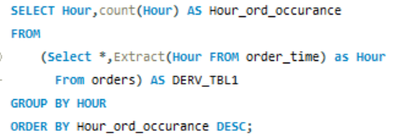
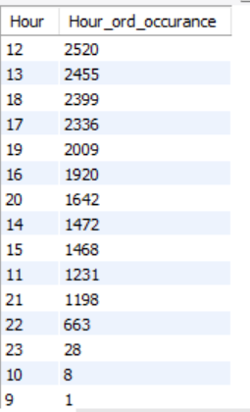
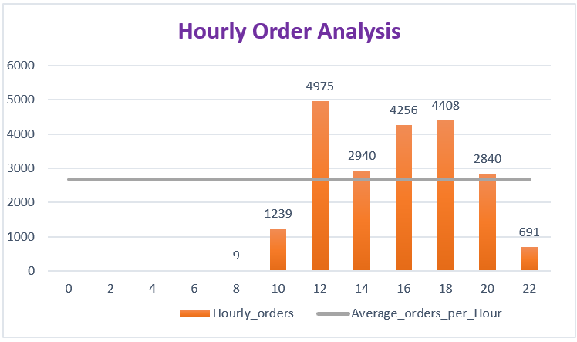
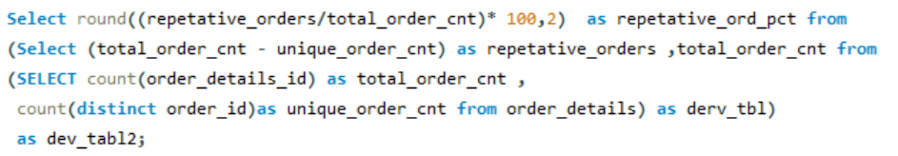
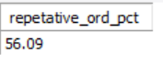
Order Trends by Hour OUTPUT
repetitive orders in terms of percentage

Slide 12
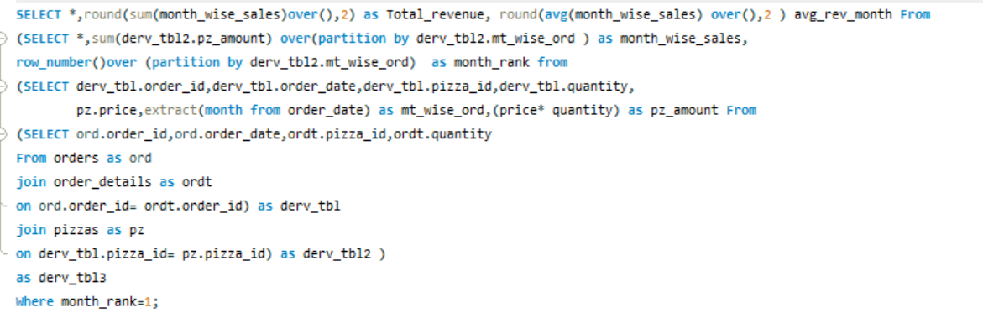
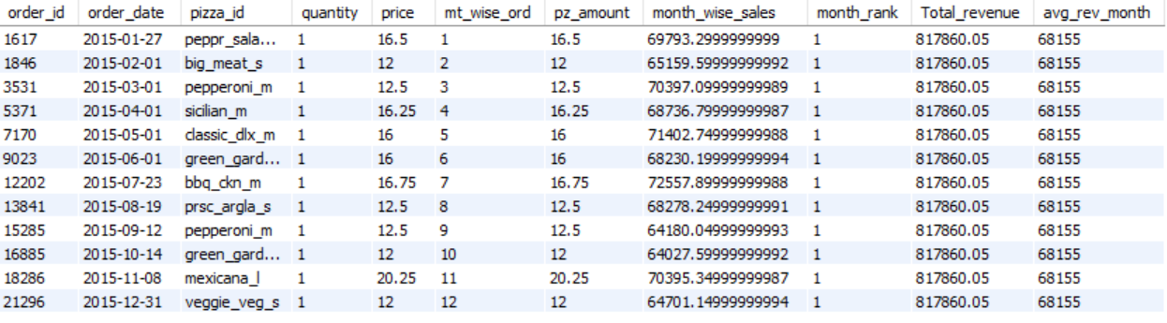
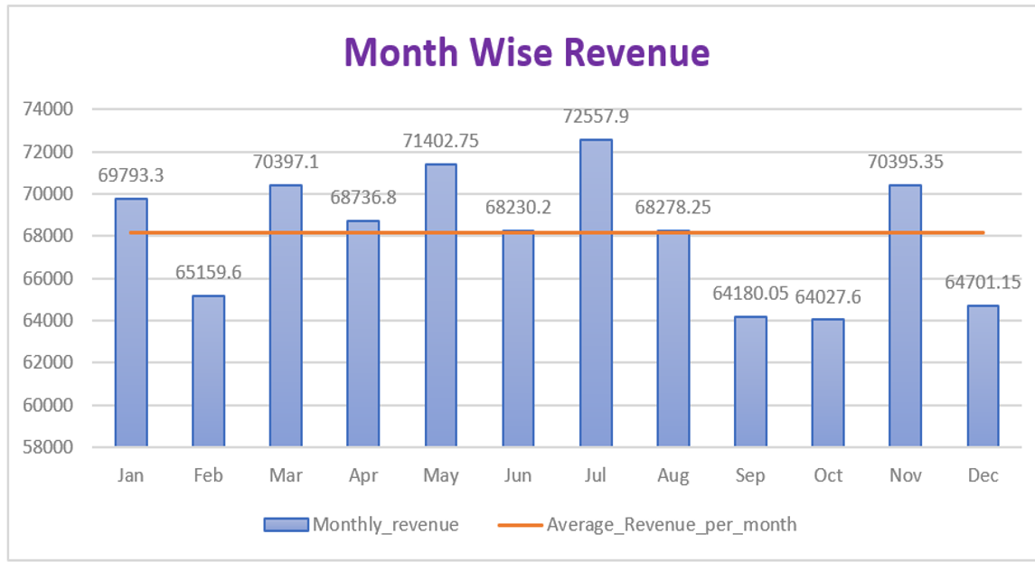
Cumulative Revenue Over Time OUTPUT

Slide 13
Key Insights
PARAMETER | INSIGHT
Revenue | $8,17,860.05
Orders | 48,620 Average :- 4052/Per-Month , 135/Per-Day
Demand Session | HIGH Demand :- July, November, March LOW Demand :- October, September, February
Orders time | Peak Orders Time :- 12PM to 9 PM Low Order Time :- 12AM to 9 AM
Revenue Contribution pizzas | TOP 5 :-Thai_ckn, Five_cheese,Four_chesse,Big_meat,Spicy_ital BOTTOM 5:- The_Greek_xxl, Calabrese_s, Ckn_alfredo_s,Mexicana_s,green_garden_l
TOP 5 Costly pizzas | The_greek_xxl($ 35.95), The_Greek_xl($25.5), Brie_carre_s($23.65), Ital_veggie_l($21), Spinch_supr($ 20.75)
Revenue Distribution | Category :- Classic (27%) , Supreme (25%) , Chicken(24%) , Veggie(24%) Order Wise :- Top 5 (15%) ,Bottom 5 (1%) , Others (84%) Cost Wise :- Top 5 (6%) , Bottom 5 (4%) , Others(90%)

Slide 14
Recommendations:-
A restructuring of pizza prices is required because the expensive 5 pizzas contribute 6% to revenue, whereas the cheaper 5 contribute 4% to revenue. Most of the revenue comes from the average pizza price.
At least 5 pizzas contribute only 1% to total revenue, so the ingredients need to be changed to improve the taste. If that still fails, it is better to remove them from the menu.
Most orders come in the Afternoon and Evening, so more staff are required during these times. After the 21st hour(10 PM), orders decrease, and we can manage with fewer staff.
Instead of selling pizzas individually, create combo packs with the highest-ordered pizzas and the lowest-ordered pizzas at a reasonable price.
In the chicken category, the top 3 ordered pizzas contribute significantly to total revenue. However, the overall quantity-wise performance is poor, so we need to identify the issue.
During low-demand times (such as festival seasons and month-end), offer discounts on pizzas.

Slide 15
Additional Recommendations:-
Offering a referral bonus can help attract new customers.
If a customer spends $500, providing a 20%-25% discount on their next order will encourage increased spending behaviour.
For regular customers, provide excellent service and small discounts to support them during low-demand periods.
During festival times, conduct a lucky draw to help boost sales during low-demand periods

Slide 16

For Consulting us

